Slide 1
Capstone Project
TMDB Movie Data Analysis
-Rohan Deshmukh
DA92S9-EN12024077730

Slide 2
Business Objective
Movies that cost over $100 million can still fail, why so? Movie lovers might have different interests. A production company wants to analyze a movie dataset to identify what kinds of movies perform well in cinemas, which genres they belong to, and so on. It will help the company predict if a movie will be a commercial success, if the movie will be highly rated, etc. To begin with, the management has asked Peter, a data analyst, to answer certain questions by carrying out the upcoming tasks. You are required to help Peter write Python codes in a Python notebook to perform these tasks.

Slide 3
Problem Statements
TASK - 1: Load the movie dataset in the Python notebook. Display the numbers of rows and columns in the dataset. Display the titles and genres of the first 50 movies from the dataset.
TASK - 2: Identify the columns that have null values and perform the null value treatment. (Choose the imputation method based on the type of data in the columns of interest)
TASK - 3: Display the movie categories that have a budget greater than $220,000.
TASK - 4: Display the movie categories where the revenue is greater than $961,000,000.
TASK - 5: In the dataset, there are some movies for which the budget and revenue columns have the value 0, which mean unknown values. Remove the rows with value 0 from both the budget and revenue columns.
TASK-6: List the top 10 movies with the highest revenues and the top 10 movies with the least budget.
TASK - 7: How are popularities of movies related with the movie budgets? Are they correlated or totally uncorrelated with each other? Write the interpretation of your analysis.
TASK - 8: Identify and display the names of all production companies along with the number of times they appear in the dataset.
TASK-9: Display the names of the top 25 production companies based on the number of movies they have produced in descending order of the number of movies produced.
TASK -10: Sort the data in descending order based on revenue and filter the top 500 movies. Find the measures of central tendency for the following columns using the filtered data:
Budget
revenue
runtime
Perform outlier analysis for the above three columns using box plots.
TASK-11: Identify and display the names of the movies along with their run times for those movies that have above average runtime, using the data from the previous task.

Slide 4
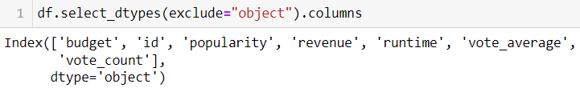
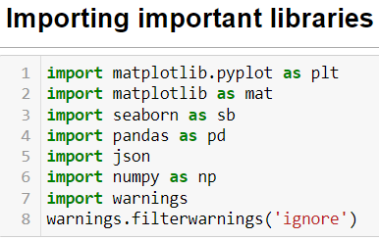
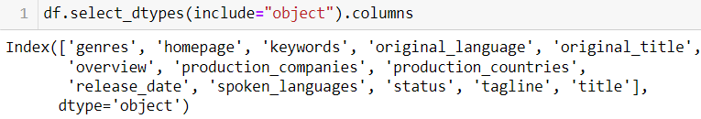
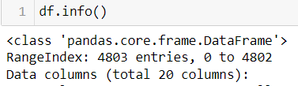
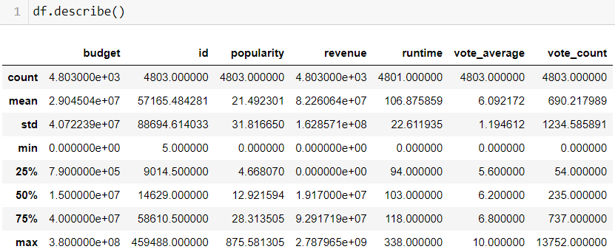
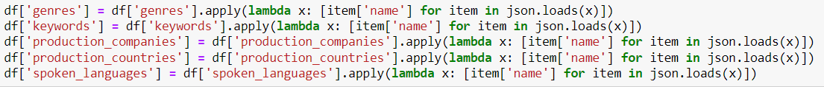
Loading of data, Level 0 Analysis and Conversion of data for viewing
Getting
Numerical Column
Getting
Categorical Column
Loading data into data-frame using read function
Using Info() for getting data information
Using describe to get all numerical data's IQR information
Using Lambda function to convert Json text to list for viewing

Slide 5
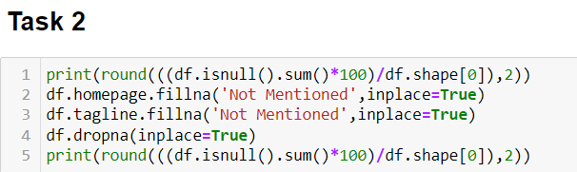
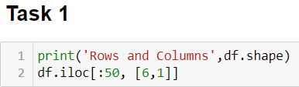
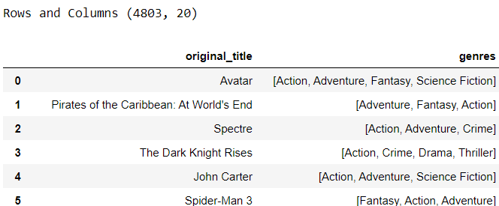
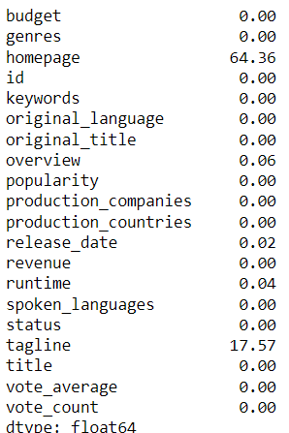
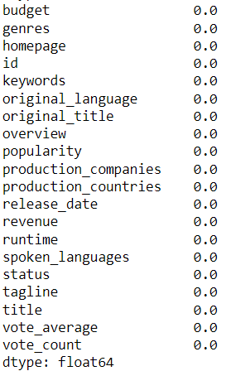
TMDB Movie Data Analysis Task
By using shape function we are getting rows and column of data frame and iloc for displaying specific number of rows and specific column
we replaced null value whose percentage above 15% to not mentioned and rest we just removed null values

Slide 6
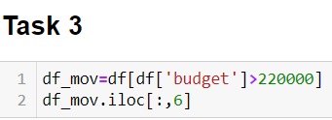
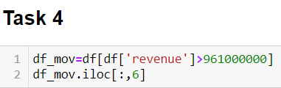
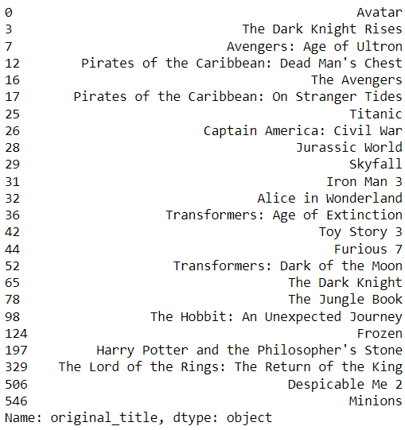
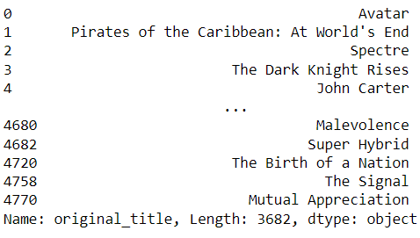
TMDB Movie Data Analysis Task
By using filters we displayed movie name for budget >$220000
By using filters we displayed movie name for revenue >$961000000

Slide 7
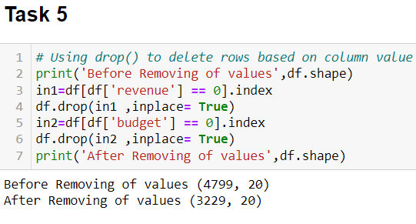
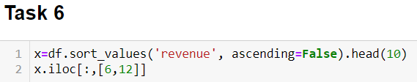

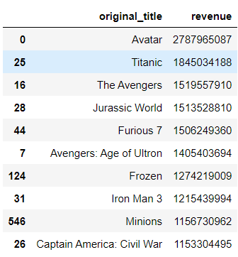
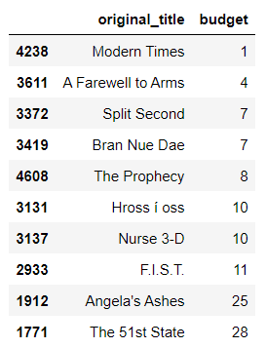
TMDB Movie Data Analysis Task
We used drop function to remove data such as revenue and budget as zero by using index and data was reduced by 1570
We sorted Budget and Revenue values in ascending and descending respectively and used head function get top 10 from that sorting

Slide 8
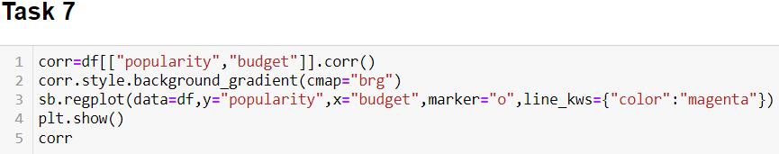
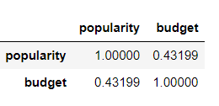
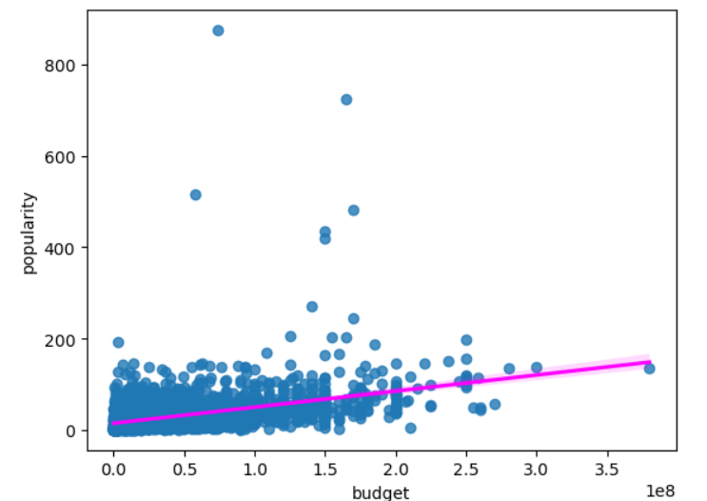
TMDB Movie Data Analysis Task
There is moderate positive relationship between Budget and Popularity of around 43%

Slide 9
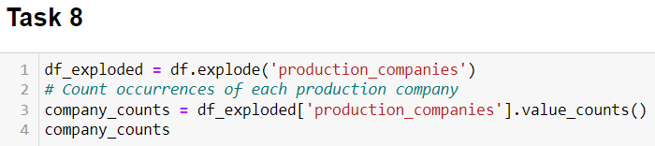
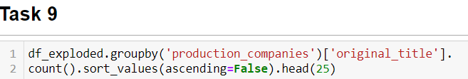
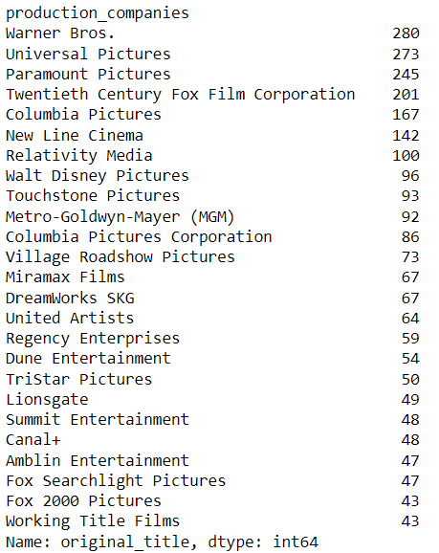
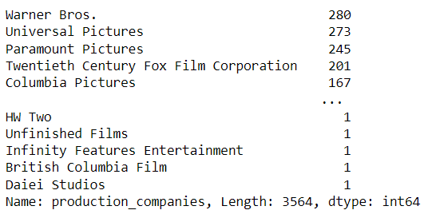
TMDB Movie Data Analysis Task
By using Explode function on specific column we created list value to separate column values and then got the count of production companies who made how much movies
We used group by function on to previous task data frame got no. of movies created by production companies and head for top 25

Slide 10
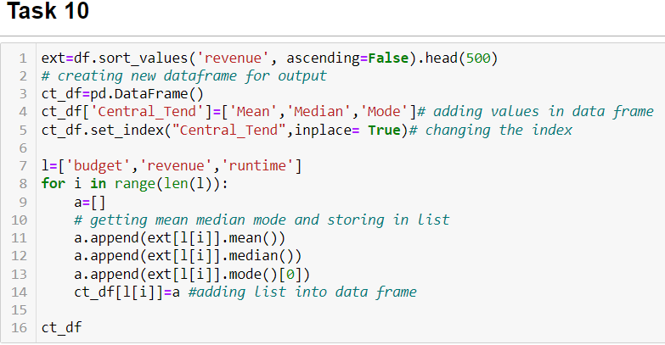
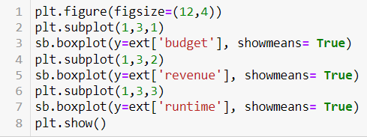
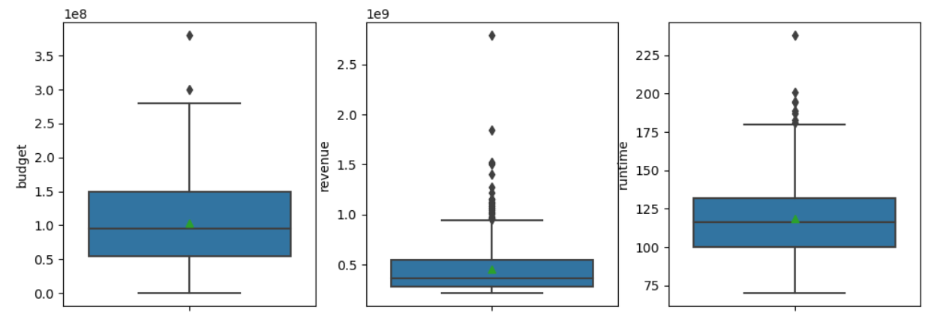
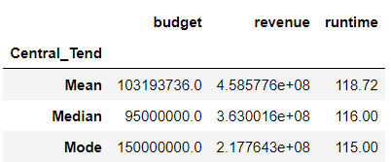
TMDB Movie Data Analysis Task
Outlier analysis
We can say that there 2 outlier in Budget but remaining both have lot of outliers
Both Budget and Revenue have Right skew and for Runtime its almost no skew

Slide 11
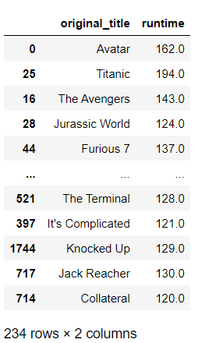
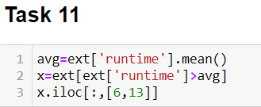
TMDB Movie Data Analysis Task
By using dataframe from previous filtering data with runtime > average runtime and we got around 234 movies have runtime above average runtime

Slide 12
SUMMARY
Budget and popularity are correlated by around 43’14% , but other factors also contribute to success.
Runtime is not related to success.
Budget and revenue distributions are right-skewed, meaning a few films have very high budgets and revenue, but most films have lower budgets and revenue.

Slide 13
THANK YOU
-Rohan Deshmukh
DA92S9-EN12024077730

